Slide 1
Digestive system in insects

Slide 2
The digestive system is the group of organs and structures in living organisms that are responsible for breaking down food, absorbing nutrients, and eliminating waste.

Slide 3
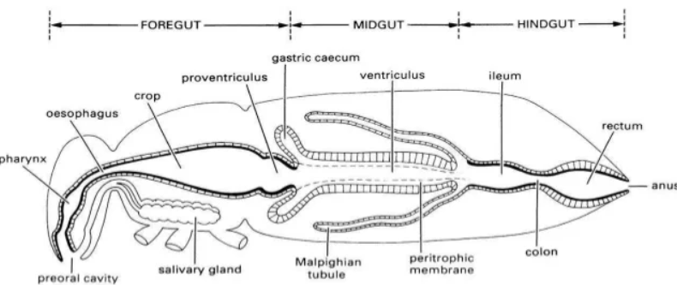

Slide 4
The digestive system of insects is well-developed and adapted to their diverse feeding habits (herbivorous, carnivorous, sap-sucking, blood-feeding, etc.).
It is a complete alimentary canal, starting at the mouth and ending at the anus.

Slide 5
Alimentay canal of insecst is long, muscular and tubular.
Foregut (Stomodaeum)
Midgut (Mesenteron)
Hindgut (Proctodaeum)
Along with associated glands like salivary glands and Malpighian tubules.

Slide 6
Foregut (Stomodaeum)
Origin: Ectodermal, lined with cuticle
Parts:
  Mouth: Ingestion of food
  Pharynx: Muscular, pushes the food into oesophagus.

Slide 7
  Oesophagus: Narrow tube carrying food from pharynx to crop.
  Crop: A thin-walled sac, act as food reservoir.
  Proventriculus (Gizzard): Muscular and sometimes lined with sclerotized teeth/spines → grinds food into smaller particles (especially in chewing insects like cockroaches, grasshoppers).

Slide 8
Food flow from foregut to midgut is regulated through cardiac valve or oesophageal valve.
Main function: Ingestion, storage, mechanical breakdown of food.

Slide 9
2. Midgut (Mesenteron)
Origin: Endodermal, not lined with cuticle.
Main function: Chemical digestion & absorption of nutrients.
Parts:
  Gastric caeca: Blind pouches increasing surface area; secrete digestive enzymes and enhance absorption.
  Pyrolic valve

Slide 10
Ventriculus (Stomach): Major site of enzymatic digestion. Enzymes like amylase, lipase, protease secreted.
Peritrophic membrane: A semi-permeable chitin-protein sheet secreted by midgut cells → surrounds food bolus, protects gut wall from abrasion and pathogens, but allows enzymes and digested nutrients to pass.

Slide 11
3. Hindgut (Proctodaeum)
Origin: Ectodermal, lined with cuticle.
This cuticular lining is permeable to salts, ions, amino acids and water.
Main function: Absorption of water, salts, and excretion of feces.

Slide 12
Parts:
  Ileum: Short segment connecting midgut to colon, sometimes with folds to increase absorption.
  Colon: Absorbs remaining nutrients and water, compacts waste.
  Rectum: contains rectal pads helping in dehydration of faeces. very important for terrestrial insects in conserving water.
  Anus: Expels feces.

Slide 13
Associated Structures
Salivary glands:
  Produce saliva for lubrication of food.
  Contain digestive enzymes (like invertase in bees).
  In blood-feeding insects → saliva may contain anticoagulants.
Malpighian tubules (excretory + digestive association):
  Arise at the junction of midgut and hindgut.
  Remove nitrogenous wastes (uric acid, ammonia, urea).
  Help maintain ionic and water balance.
  Work closely with hindgut to conserve water.

Slide 14
